Slide 1




CIT 596 MODULE 14.3
Subset-sum
Sampath Kannan

Slide 2



SUBSET-SUM
Subset-sum decision problem:
Instance: $n \text{numbers} a_{1}, a_{2},⋯,a_{n}$ and a target $T$
Question: is there a subset $S$ of the indices such that $\sum_{i∈S}{a_{i}=T}$?
We prove that subset sum is NP-complete by a complicated reduction from 3-SAT.
Let $φ$ be a 3-SAT instance with $n$ variables and $m$ clauses.
We create a subset sum instance with $2n+2m$ numbers, each with $n+m$ digits!

Slide 3
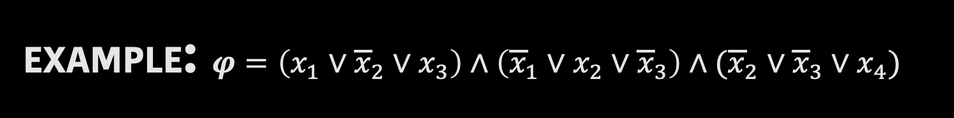



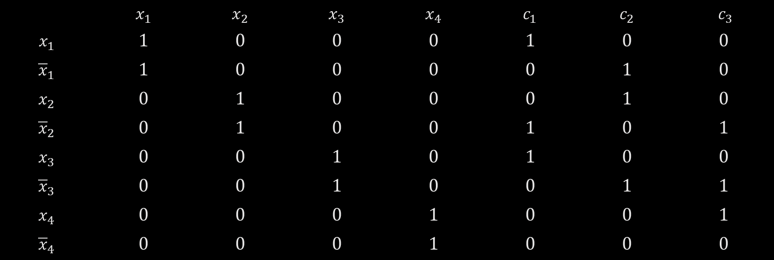
$$c_{1}$$
$$c_{2}$$
$$c_{3}$$
EXAMPLE: $φ=\left(x_{1}∨{\overline{x}}_{2}∨x_{3}\right)∧\left({\overline{x}}_{1}∨x_{2}∨{\overline{x}}_{3}\right)∧({\overline{x}}_{2}∨{\overline{x}}_{3}∨x_{4})$
Variables
Clauses
 | $$x_{1}$$ | $$x_{2}$$ | $$x_{3}$$ | $$x_{4}$$ | $$c_{1}$$ | $$c_{2}$$ | $$c_{3}$$
$$x_{1}$$ | $$1$$ | $$0$$ | $$0$$ | $$0$$ | $$1$$ | $$0$$ | $$0$$
$${\overline{x}}_{1}$$ | $$1$$ | $$0$$ | $$0$$ | $$0$$ | $$0$$ | $$1$$ | $$0$$
$$x_{2}$$ | $$0$$ | $$1$$ | $$0$$ | $$0$$ | $$0$$ | $$1$$ | $$0$$
$${\overline{x}}_{2}$$ | $$0$$ | $$1$$ | $$0$$ | $$0$$ | $$1$$ | $$0$$ | $$1$$
$$x_{3}$$ | $$0$$ | $$0$$ | $$1$$ | $$0$$ | $$1$$ | $$0$$ | $$0$$
$${\overline{x}}_{3}$$ | $$0$$ | $$0$$ | $$1$$ | $$0$$ | $$0$$ | $$1$$ | $$1$$
$$x_{4}$$ | $$0$$ | $$0$$ | $$0$$ | $$1$$ | $$0$$ | $$0$$ | $$1$$
$${\overline{x}}_{4}$$ | $$0$$ | $$0$$ | $$0$$ | $$1$$ | $$0$$ | $$0$$ | $$0$$

Slide 4


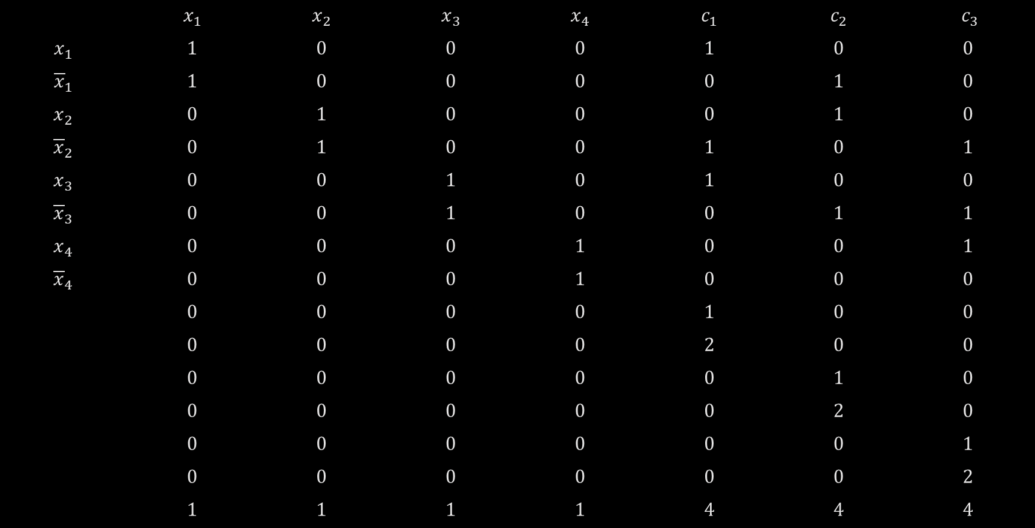


$$φ=\left(x_{1}∨{\overline{x}}_{2}∨x_{3}\right)∧\left({\overline{x}}_{1}∨x_{2}∨{\overline{x}}_{3}\right)∧({\overline{x}}_{2}∨{\overline{x}}_{3}∨x_{4})$$
$$c_{1}$$
$$c_{2}$$
$$c_{3}$$
Variables
Clauses
 | $$x_{1}$$ | $$x_{2}$$ | $$x_{3}$$ | $$x_{4}$$ | $$c_{1}$$ | $$c_{2}$$ | $$c_{3}$$
$$x_{1}$$ | $$1$$ | $$0$$ | $$0$$ | $$0$$ | $$1$$ | $$0$$ | $$0$$
$${\overline{x}}_{1}$$ | $$1$$ | $$0$$ | $$0$$ | $$0$$ | $$0$$ | $$1$$ | $$0$$
$$x_{2}$$ | $$0$$ | $$1$$ | $$0$$ | $$0$$ | $$0$$ | $$1$$ | $$0$$
$${\overline{x}}_{2}$$ | $$0$$ | $$1$$ | $$0$$ | $$0$$ | $$1$$ | $$0$$ | $$1$$
$$x_{3}$$ | $$0$$ | $$0$$ | $$1$$ | $$0$$ | $$1$$ | $$0$$ | $$0$$
$${\overline{x}}_{3}$$ | $$0$$ | $$0$$ | $$1$$ | $$0$$ | $$0$$ | $$1$$ | $$1$$
$$x_{4}$$ | $$0$$ | $$0$$ | $$0$$ | $$1$$ | $$0$$ | $$0$$ | $$1$$
$${\overline{x}}_{4}$$ | $$0$$ | $$0$$ | $$0$$ | $$1$$ | $$0$$ | $$0$$ | $$0$$
 | $$0$$ | $$0$$ | $$0$$ | $$0$$ | $$1$$ | $$0$$ | $$0$$
 | $$0$$ | $$0$$ | $$0$$ | $$0$$ | $$2$$ | $$0$$ | $$0$$
 | $$0$$ | $$0$$ | $$0$$ | $$0$$ | $$0$$ | $$1$$ | $$0$$
 | $$0$$ | $$0$$ | $$0$$ | $$0$$ | $$0$$ | $$2$$ | $$0$$
 | $$0$$ | $$0$$ | $$0$$ | $$0$$ | $$0$$ | $$0$$ | $$1$$
 | $$0$$ | $$0$$ | $$0$$ | $$0$$ | $$0$$ | $$0$$ | $$2$$
 | $$1$$ | $$1$$ | $$1$$ | $$1$$ | $$4$$ | $$4$$ | $$4$$

Slide 5




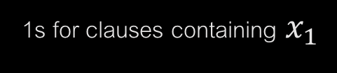
Each row is one of the numbers in subset sum instance created by the reduction:
Variables
Clauses
1s for clauses containing $x_{1}$
$$x_{1}$$ | $$x_{2}$$ | $$…$$ | $$x_{n}$$
$$1$$ | $$0$$ | $$…$$ | $$0$$
$$1$$ | $$0$$ | $$…$$ | $$0$$
$$⋮$$
$$0 1 0 0 1 0 ⋯ 0 0 1 0$$
$$n$$
$$2m$$

Slide 6
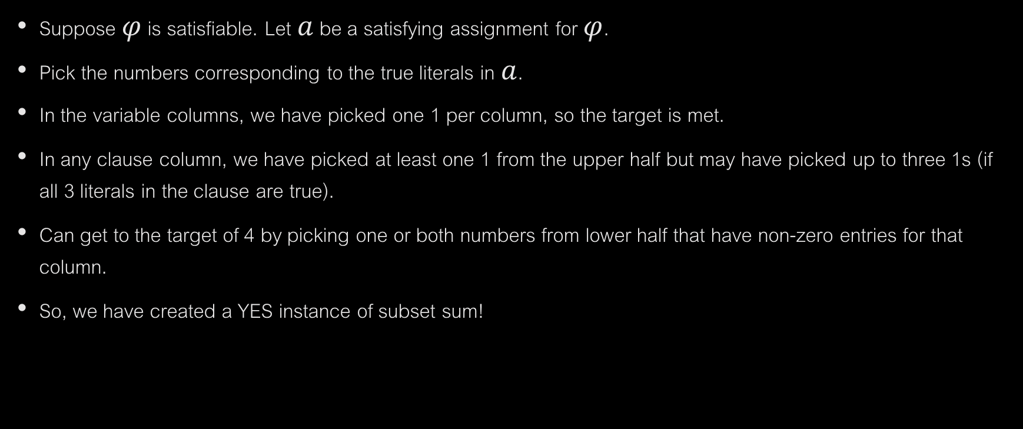
PROOF OF CORRECTNESS
Suppose $φ$ is satisfiable. Let $a$ be a satisfying assignment for $φ$.
Pick the numbers corresponding to the true literals in $a$.
In the variable columns, we have picked one 1 per column, so the target is met.
In any clause column, we have picked at least one 1 from the upper half but may have picked up to three 1s (if all 3 literals in the clause are true).
Can get to the target of 4 by picking one or both numbers from lower half that have non-zero entries for that column.
So, we have created a YES instance of subset sum!

Slide 7
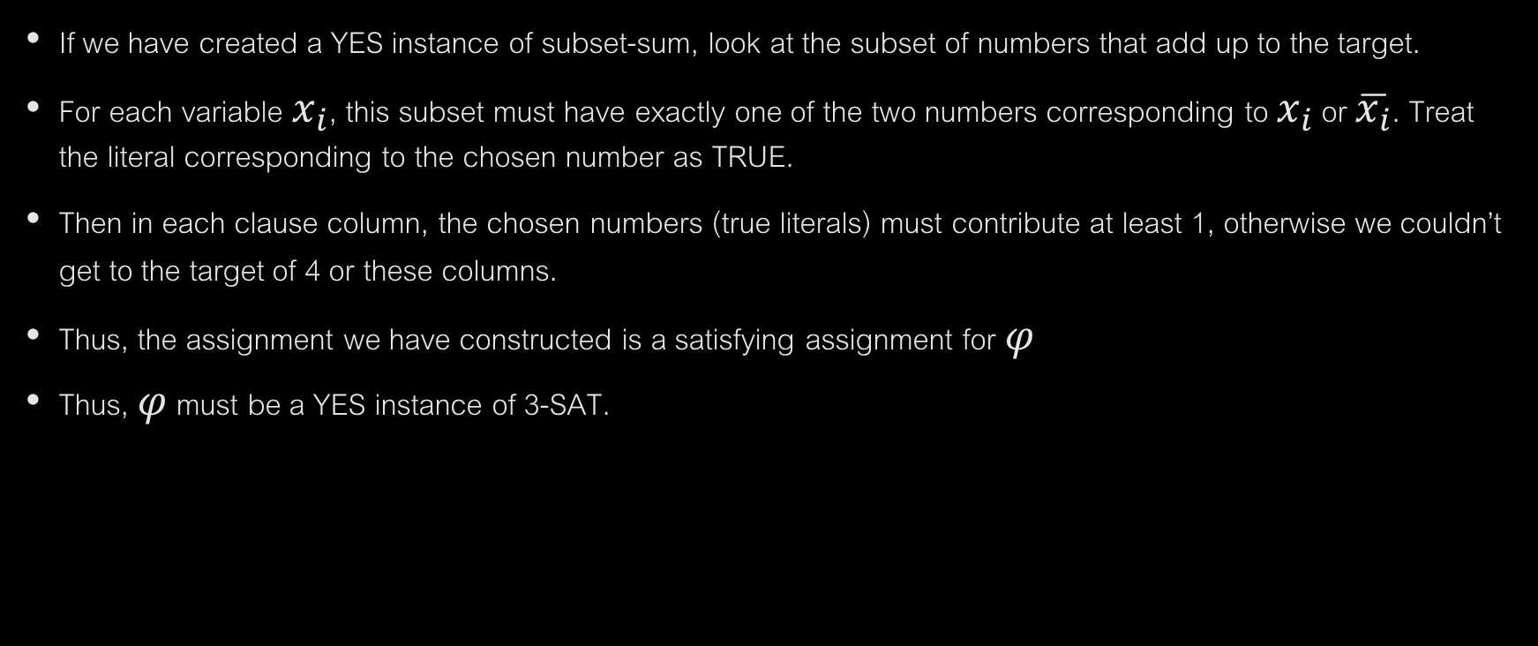
CONVERSELY…
If we have created a YES instance of subset-sum, look at the subset of numbers that add up to the target.
For each variable $x_{i}$, this subset must have exactly one of the two numbers corresponding to $x_{i}$ or $\overline{x_{i}}$. Treat the literal corresponding to the chosen number as TRUE.
Then in each clause column, the chosen numbers (true literals) must contribute at least 1, otherwise we couldn’t get to the target of 4 or these columns.
Thus, the assignment we have constructed is a satisfying assignment for $φ$
Thus, $φ$ must be a YES instance of 3-SAT.

Slide 8
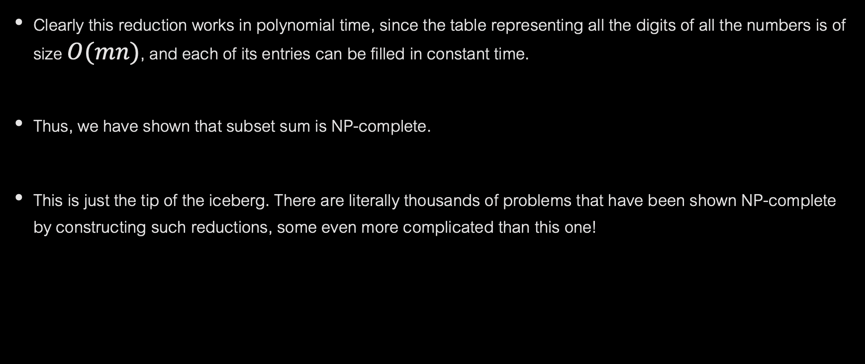
WRAPPING UP
Clearly this reduction works in polynomial time, since the table representing all the digits of all the numbers is of size $O(mn)$, and each of its entries can be filled in constant time.
Thus, we have shown that subset sum is NP-complete.
This is just the tip of the iceberg. There are literally thousands of problems that have been shown NP-complete by constructing such reductions, some even more complicated than this one!

